Slide 1

The Acquisition of having an Automated Streamline in Déjà Brew.
LESSON 2
LESSON 3
LESSON 4
Notes:
INTRODUCE YOURSELF-
ONE PERSON- : GOOD AFTERNOON, I’M ..
2ND PERSON: IM
AND SO ON.
ACQUISITION MEANS TO IMPLEMENT OR TO ACQUIRE
STREAMLINE - TO MAKE AN EFFECTIVE SYSTEM THAT WILL BENEFIT THE CLIENT.
ARLYNE

Slide 2
DESIGN PROCEDURE TIMELINE TOOLS
LESSON 2
LESSON 3
LESSON 4
Notes:
INTRODUCE YOURSELF-
ONE PERSON- : GOOD AFTERNOON, I’M ..
2ND PERSON: IM
AND SO ON.
ACQUISITION MEANS TO IMPLEMENT OR TO ACQUIRE
STREAMLINE - TO MAKE AN EFFECTIVE SYSTEM THAT WILL BENEFIT THE CLIENT.
ARLYNE

Slide 3
Design Procedure
DISCOVER
- User Research
- Stakeholders Interview
- Empathize Analysis
DEFINE
- Problem Statement
-Goal Statement
IDEATE
-Brainstorming
-User Flow or Flowcharts
DESIGN
-Moodboard or Stylescape
-Wireframes
-Mock ups
-Prototypes
DEVELOPMENT
-Front –End
-Back -End
-Testing
-Maintainance
Notes:
Alam nyo na yan NICOLE AT ALLIANNA

Slide 4
TIMELINE
LESSON 1
LESSON 2
1st WEEK | 2nd WEEK | 3rd WEEK | 4th WEEK | 5th WEEK | 6th WEEK | 7th WEEK | 8th WEEK | ONWARDS
DISCOVER
DEFINE
IDEATE
LESSON 3
LESSON 4
DESIGN
DEVELOPMENT
Notes:
ARYLENE

Slide 5
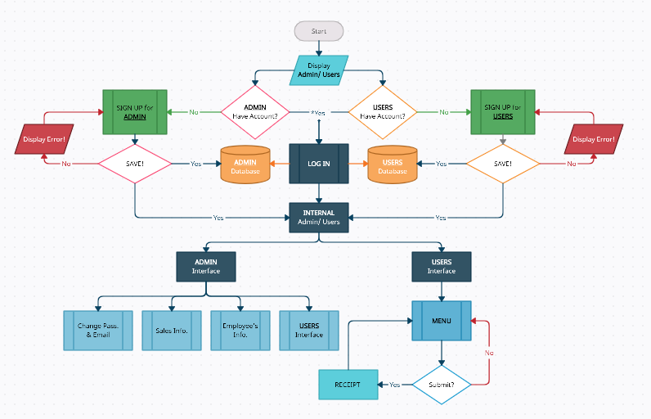
FLOWCHART
LESSON 4
Notes:
INTRODUCE YOURSELF-
ONE PERSON- : GOOD AFTERNOON, I’M ..
2ND PERSON: IM
AND SO ON.
ACQUISITION MEANS TO IMPLEMENT OR TO ACQUIRE
STREAMLINE - TO MAKE AN EFFECTIVE SYSTEM THAT WILL BENEFIT THE CLIENT.
ARLYNE

Slide 6




TOOLS
LESSON 2
LESSON 4
Notes:
ANTONETTE, LANA, JORALYN

Slide 7
WIREFRAMES & Other designs
https://www.figma.com/file/nwjxs99UfUAGuSu93syrCk/SOFTWARE-DESIGN-PROJECT?node-id=0%3A1
https://www.behance.net/gallery/152709227/WIREFRAMES
LESSON 4
Notes:
INTRODUCE YOURSELF-
ONE PERSON- : GOOD AFTERNOON, I’M ..
2ND PERSON: IM
AND SO ON.
ACQUISITION MEANS TO IMPLEMENT OR TO ACQUIRE
STREAMLINE - TO MAKE AN EFFECTIVE SYSTEM THAT WILL BENEFIT THE CLIENT.
ARLYNE

Slide 8
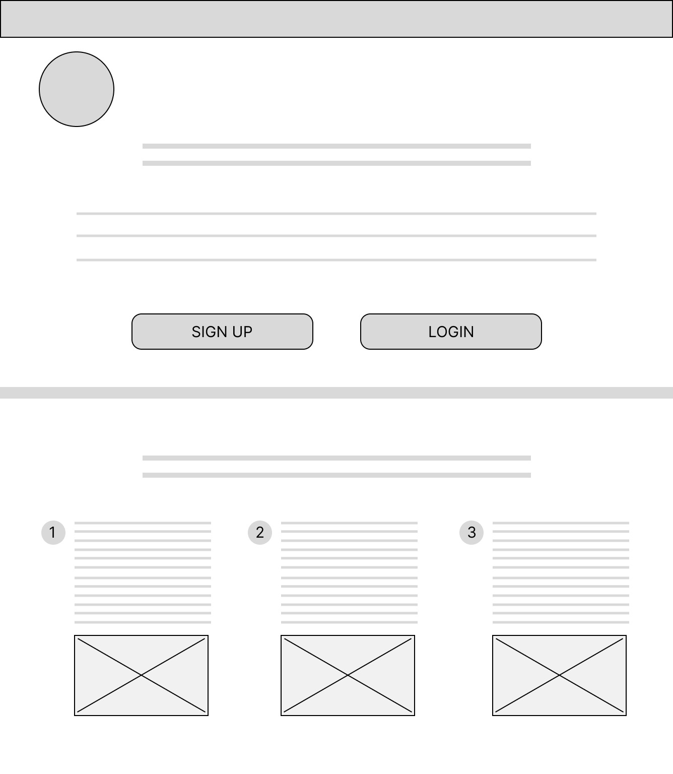
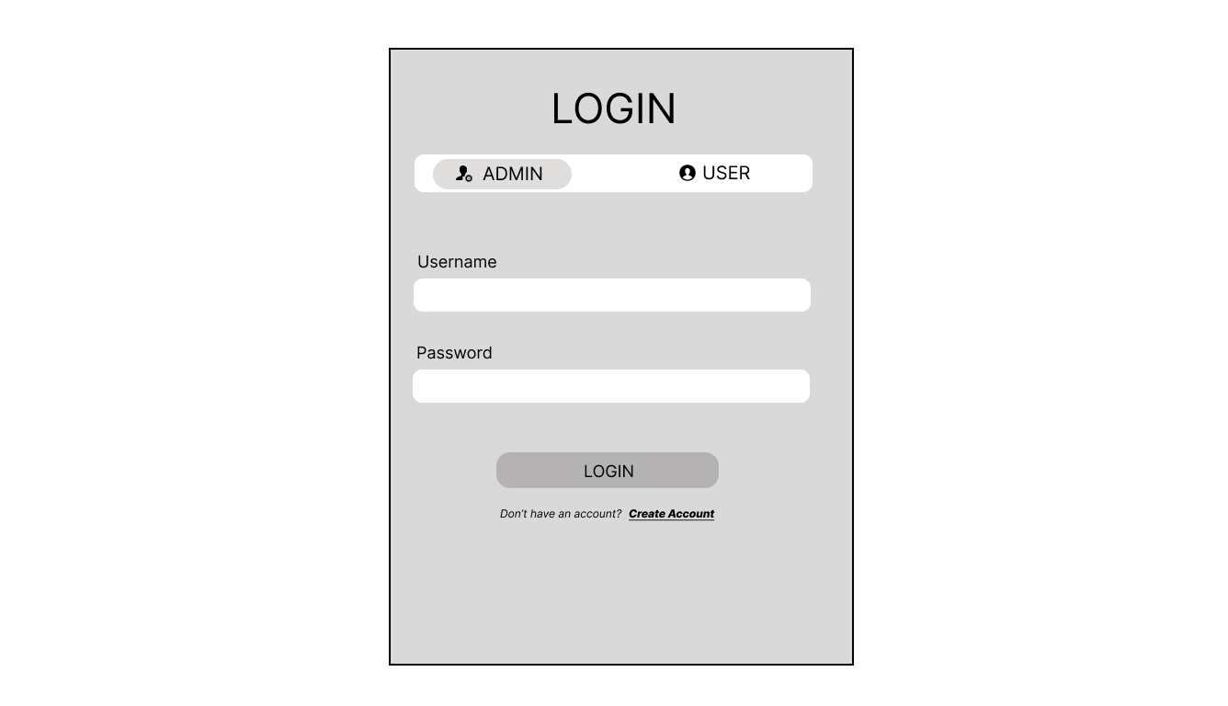
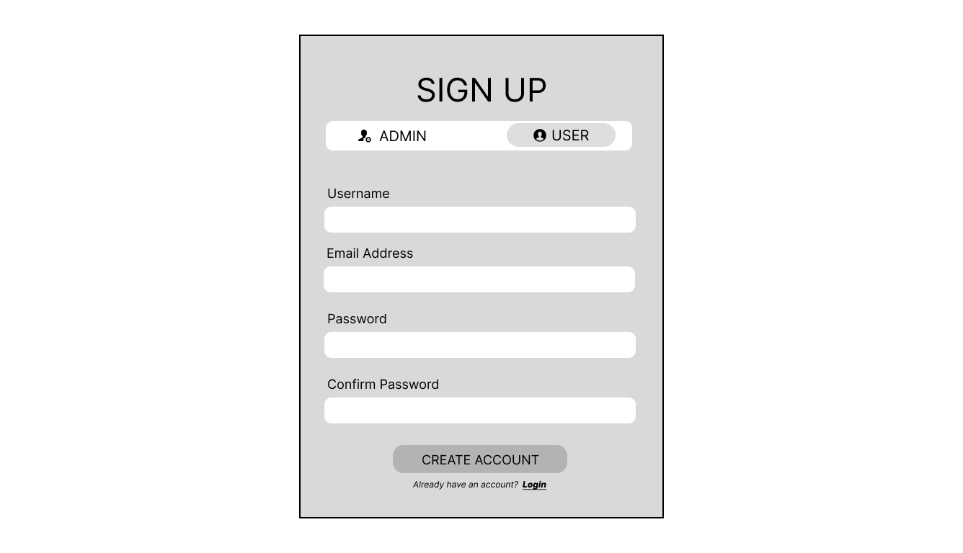
LANDING PAGE
LESSON 3
Notes:
INTRODUCE YOURSELF-
ONE PERSON- : GOOD AFTERNOON, I’M ..
2ND PERSON: IM
AND SO ON.
ACQUISITION MEANS TO IMPLEMENT OR TO ACQUIRE
STREAMLINE - TO MAKE AN EFFECTIVE SYSTEM THAT WILL BENEFIT THE CLIENT.
ARLYNE

Slide 9
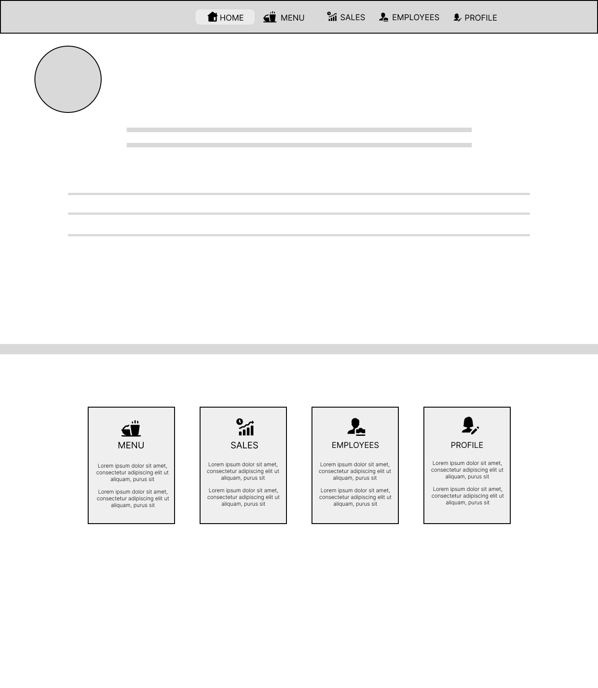
ADMIN DASHBOARD
LESSON 3
Notes:
INTRODUCE YOURSELF-
ONE PERSON- : GOOD AFTERNOON, I’M ..
2ND PERSON: IM
AND SO ON.
ACQUISITION MEANS TO IMPLEMENT OR TO ACQUIRE
STREAMLINE - TO MAKE AN EFFECTIVE SYSTEM THAT WILL BENEFIT THE CLIENT.
ARLYNE

Slide 10
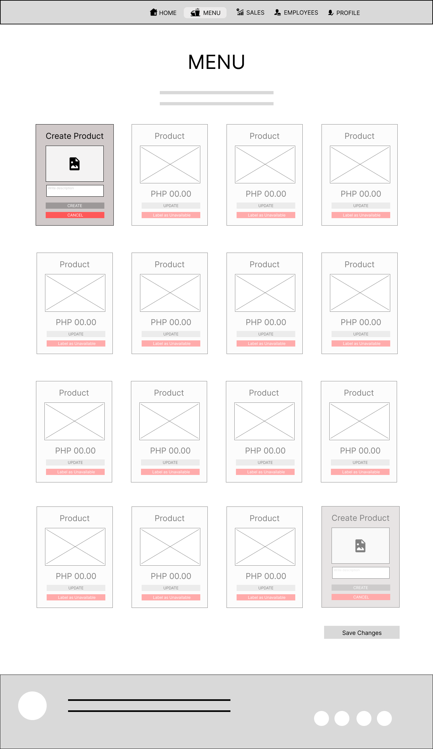
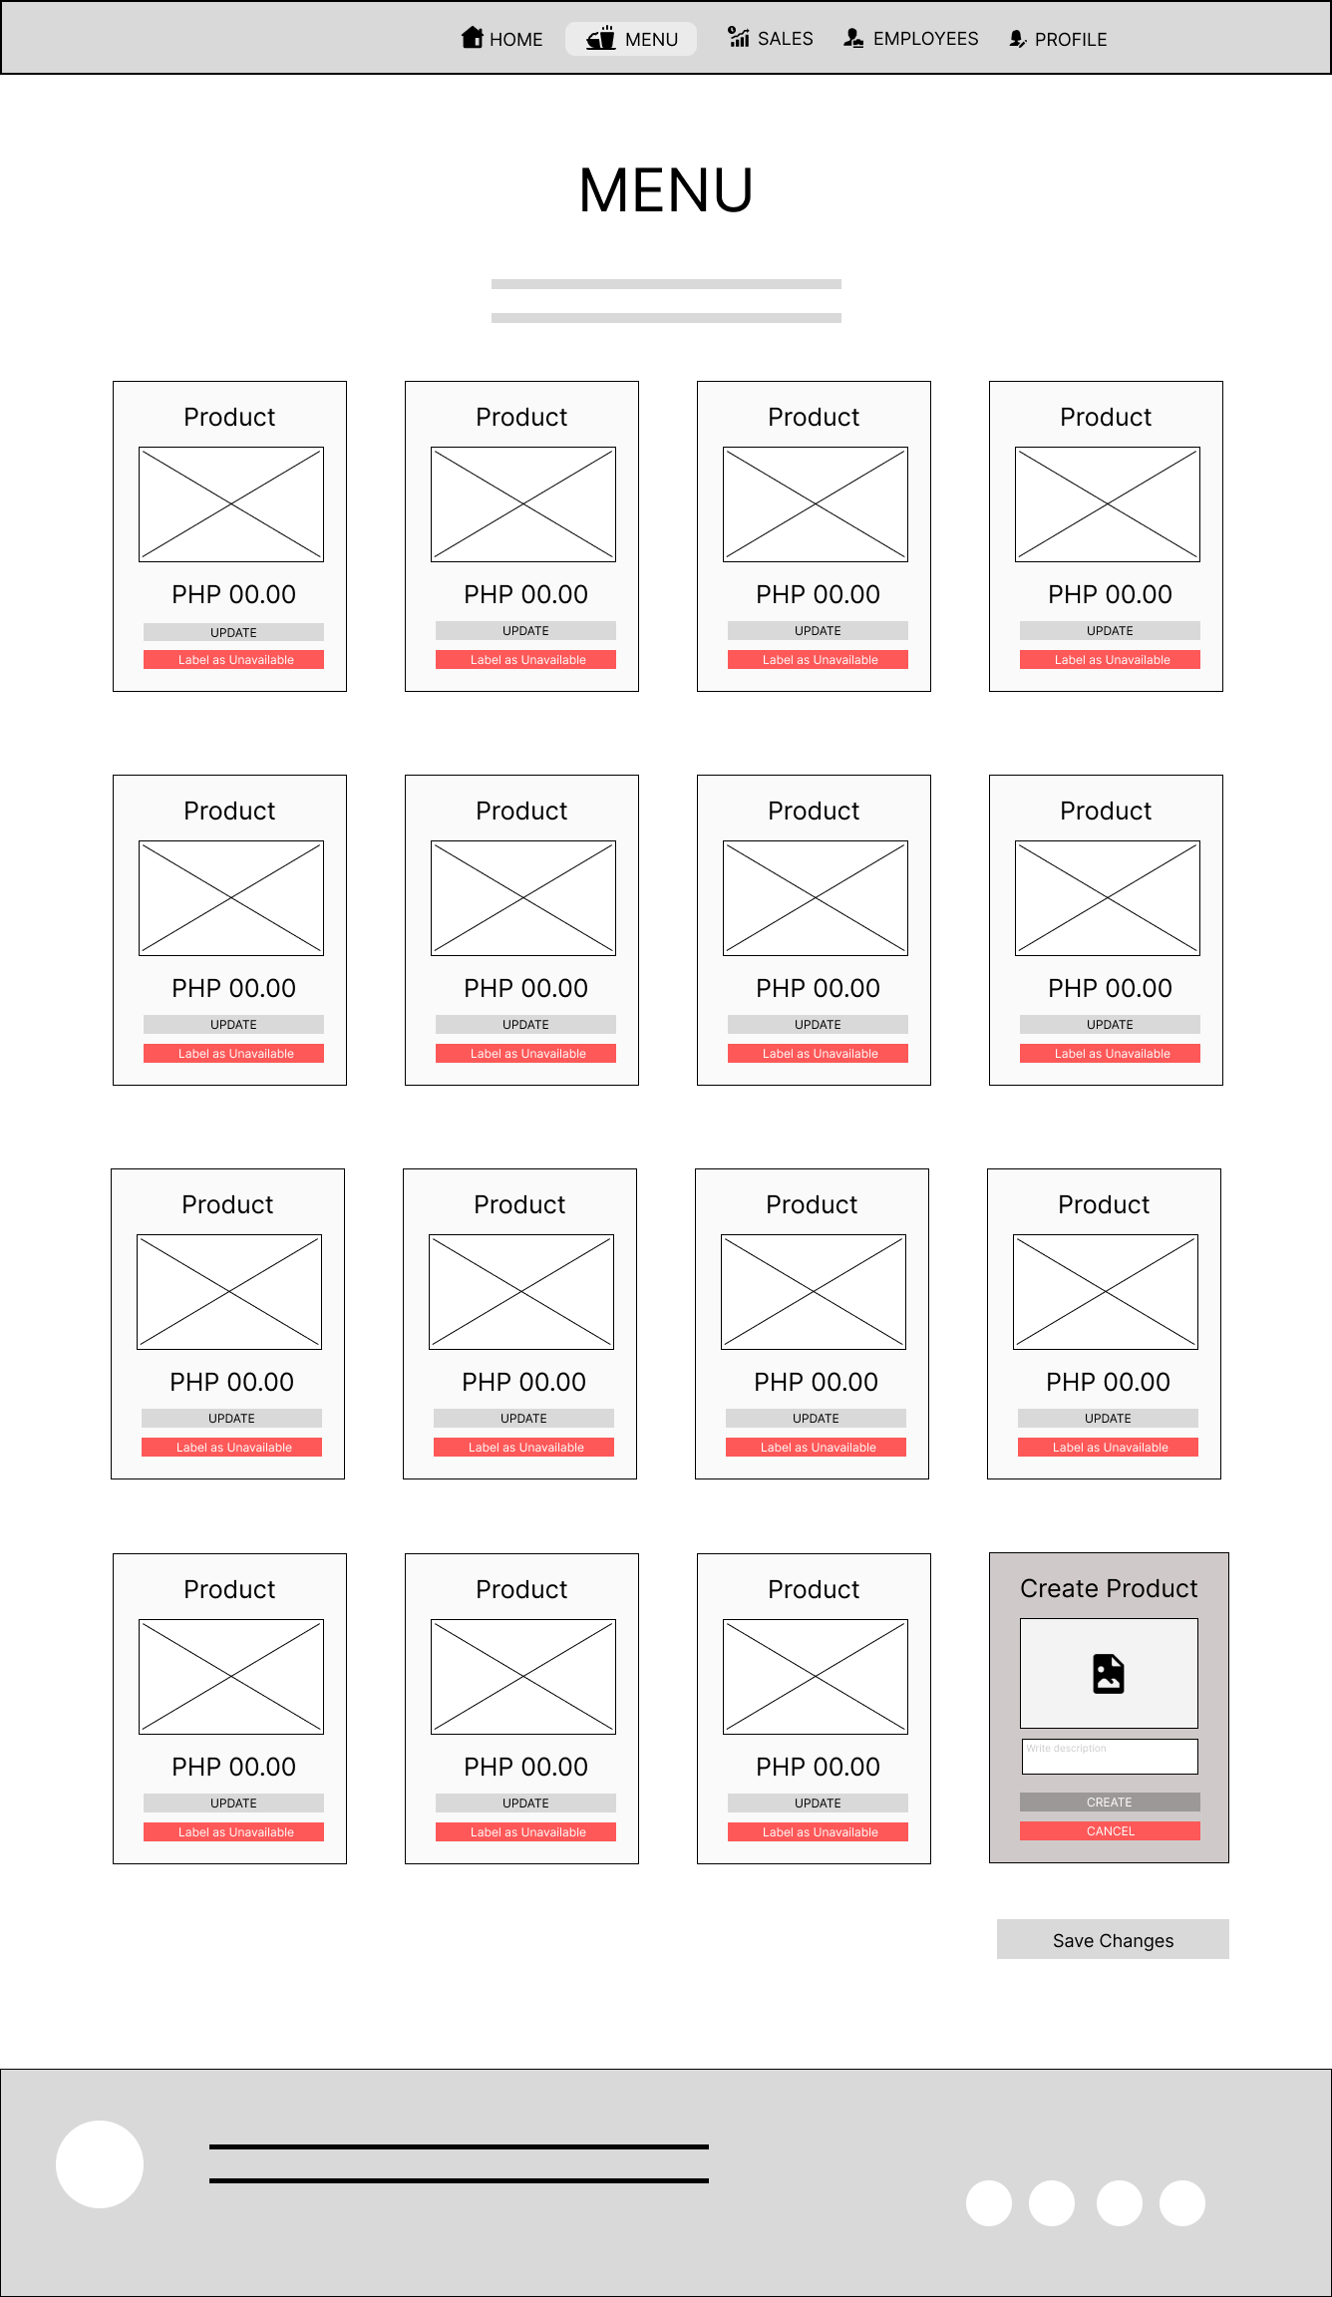
ADMIN DASHBOARD
LESSON 3
Notes:
INTRODUCE YOURSELF-
ONE PERSON- : GOOD AFTERNOON, I’M ..
2ND PERSON: IM
AND SO ON.
ACQUISITION MEANS TO IMPLEMENT OR TO ACQUIRE
STREAMLINE - TO MAKE AN EFFECTIVE SYSTEM THAT WILL BENEFIT THE CLIENT.
ARLYNE

Slide 11
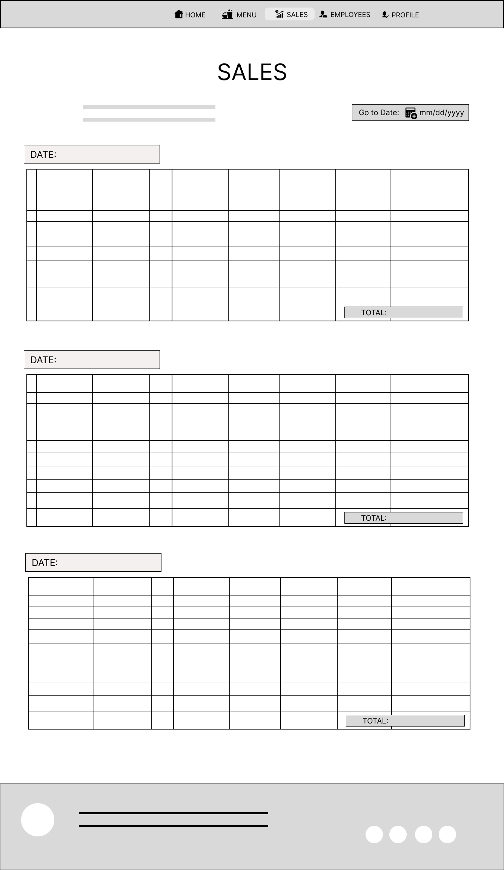
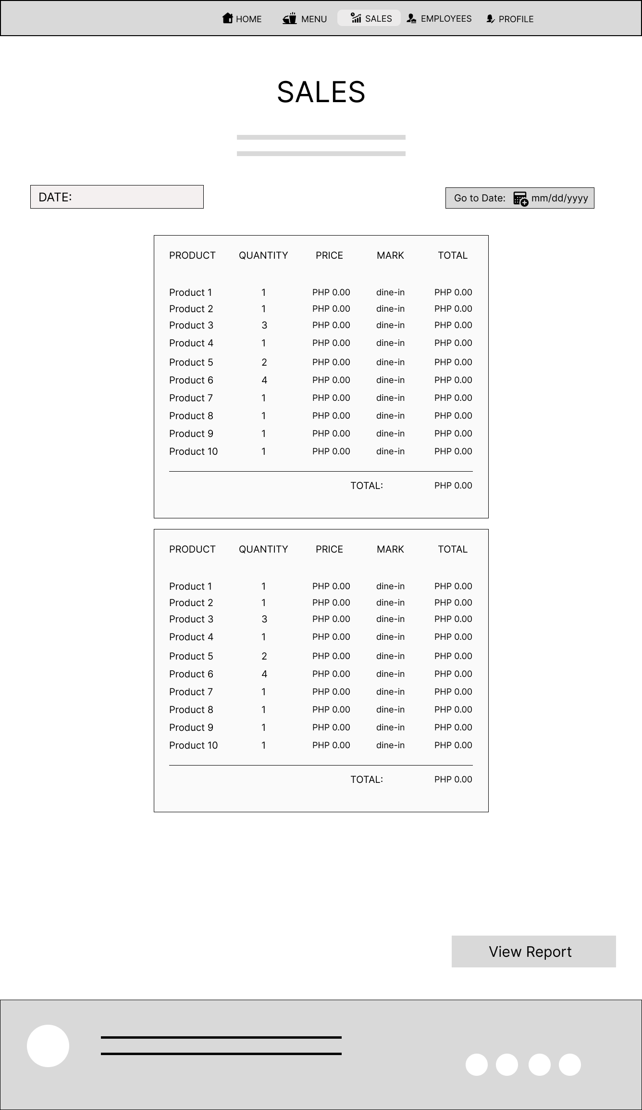
ADMIN DASHBOARD
LESSON 3
Notes:
INTRODUCE YOURSELF-
ONE PERSON- : GOOD AFTERNOON, I’M ..
2ND PERSON: IM
AND SO ON.
ACQUISITION MEANS TO IMPLEMENT OR TO ACQUIRE
STREAMLINE - TO MAKE AN EFFECTIVE SYSTEM THAT WILL BENEFIT THE CLIENT.
ARLYNE

Slide 12
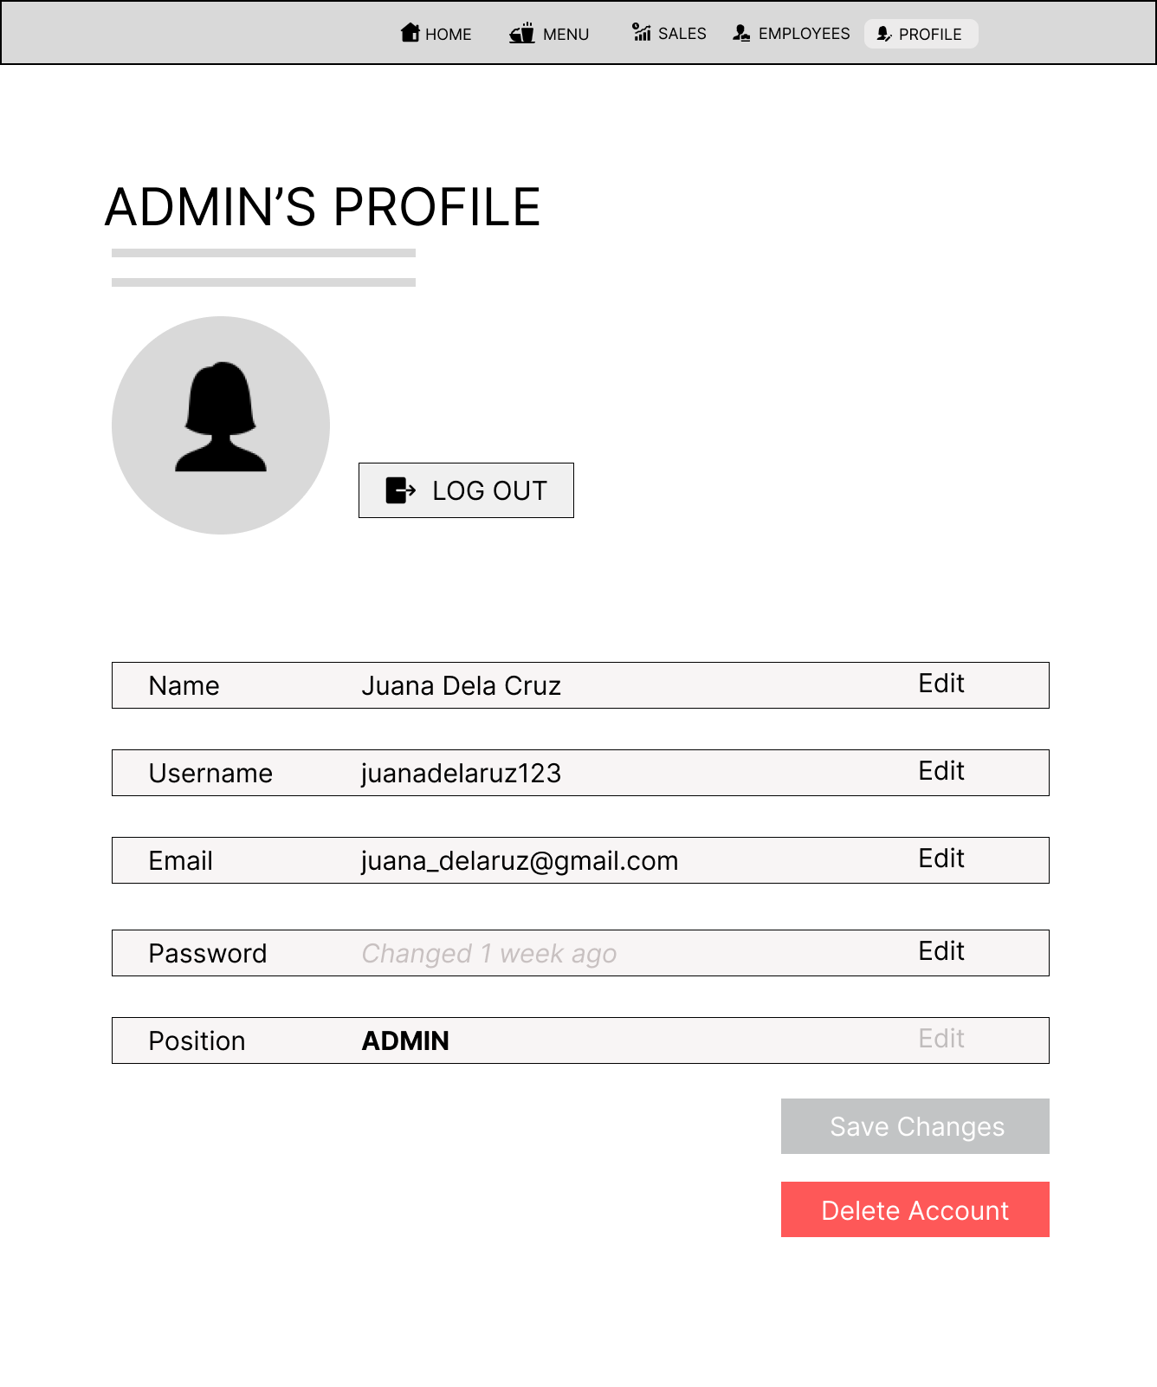
ADMIN DASHBOARD
LESSON 3
Notes:
INTRODUCE YOURSELF-
ONE PERSON- : GOOD AFTERNOON, I’M ..
2ND PERSON: IM
AND SO ON.
ACQUISITION MEANS TO IMPLEMENT OR TO ACQUIRE
STREAMLINE - TO MAKE AN EFFECTIVE SYSTEM THAT WILL BENEFIT THE CLIENT.
ARLYNE

Slide 13
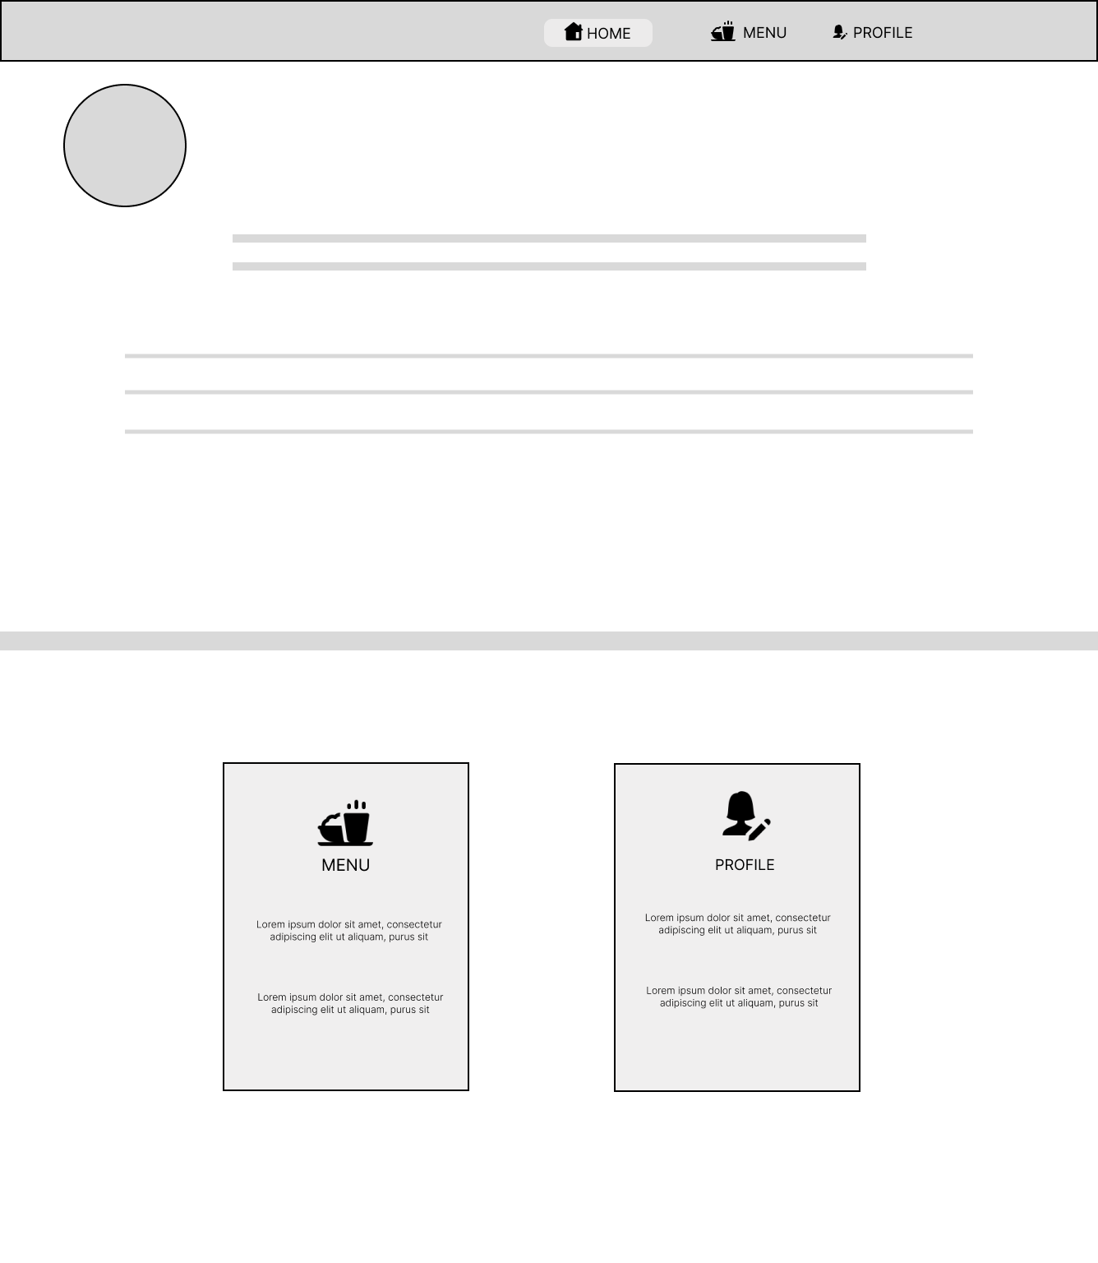
EMPLOYEE DASHBOARD
LESSON 3
Notes:
INTRODUCE YOURSELF-
ONE PERSON- : GOOD AFTERNOON, I’M ..
2ND PERSON: IM
AND SO ON.
ACQUISITION MEANS TO IMPLEMENT OR TO ACQUIRE
STREAMLINE - TO MAKE AN EFFECTIVE SYSTEM THAT WILL BENEFIT THE CLIENT.
ARLYNE

Slide 14
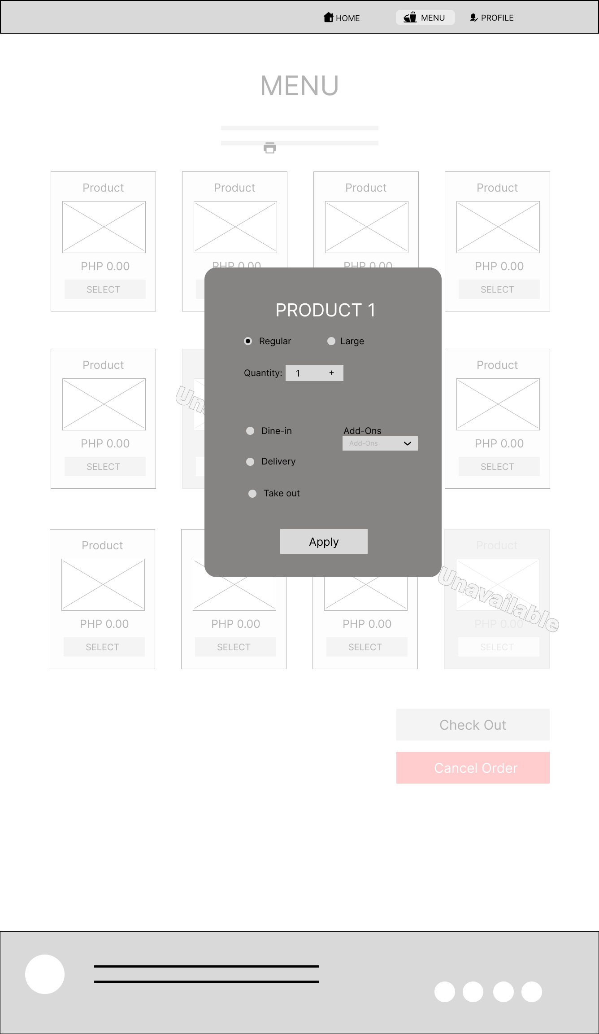
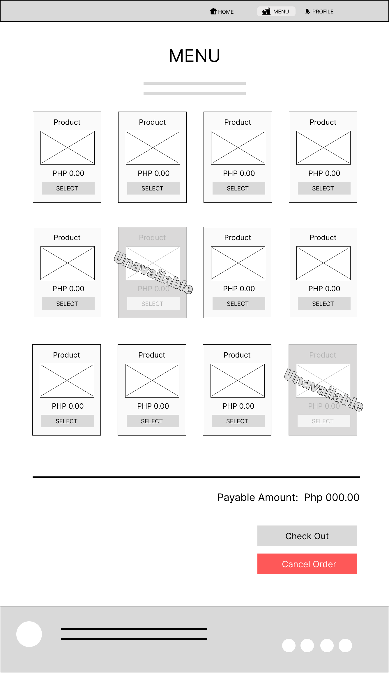
EMPLOYEE DASHBOARD
LESSON 3
Notes:
INTRODUCE YOURSELF-
ONE PERSON- : GOOD AFTERNOON, I’M ..
2ND PERSON: IM
AND SO ON.
ACQUISITION MEANS TO IMPLEMENT OR TO ACQUIRE
STREAMLINE - TO MAKE AN EFFECTIVE SYSTEM THAT WILL BENEFIT THE CLIENT.
ARLYNE

Slide 15
EMPLOYEE DASHBOARD
LESSON 3
Notes:
INTRODUCE YOURSELF-
ONE PERSON- : GOOD AFTERNOON, I’M ..
2ND PERSON: IM
AND SO ON.
ACQUISITION MEANS TO IMPLEMENT OR TO ACQUIRE
STREAMLINE - TO MAKE AN EFFECTIVE SYSTEM THAT WILL BENEFIT THE CLIENT.
ARLYNE

Slide 16
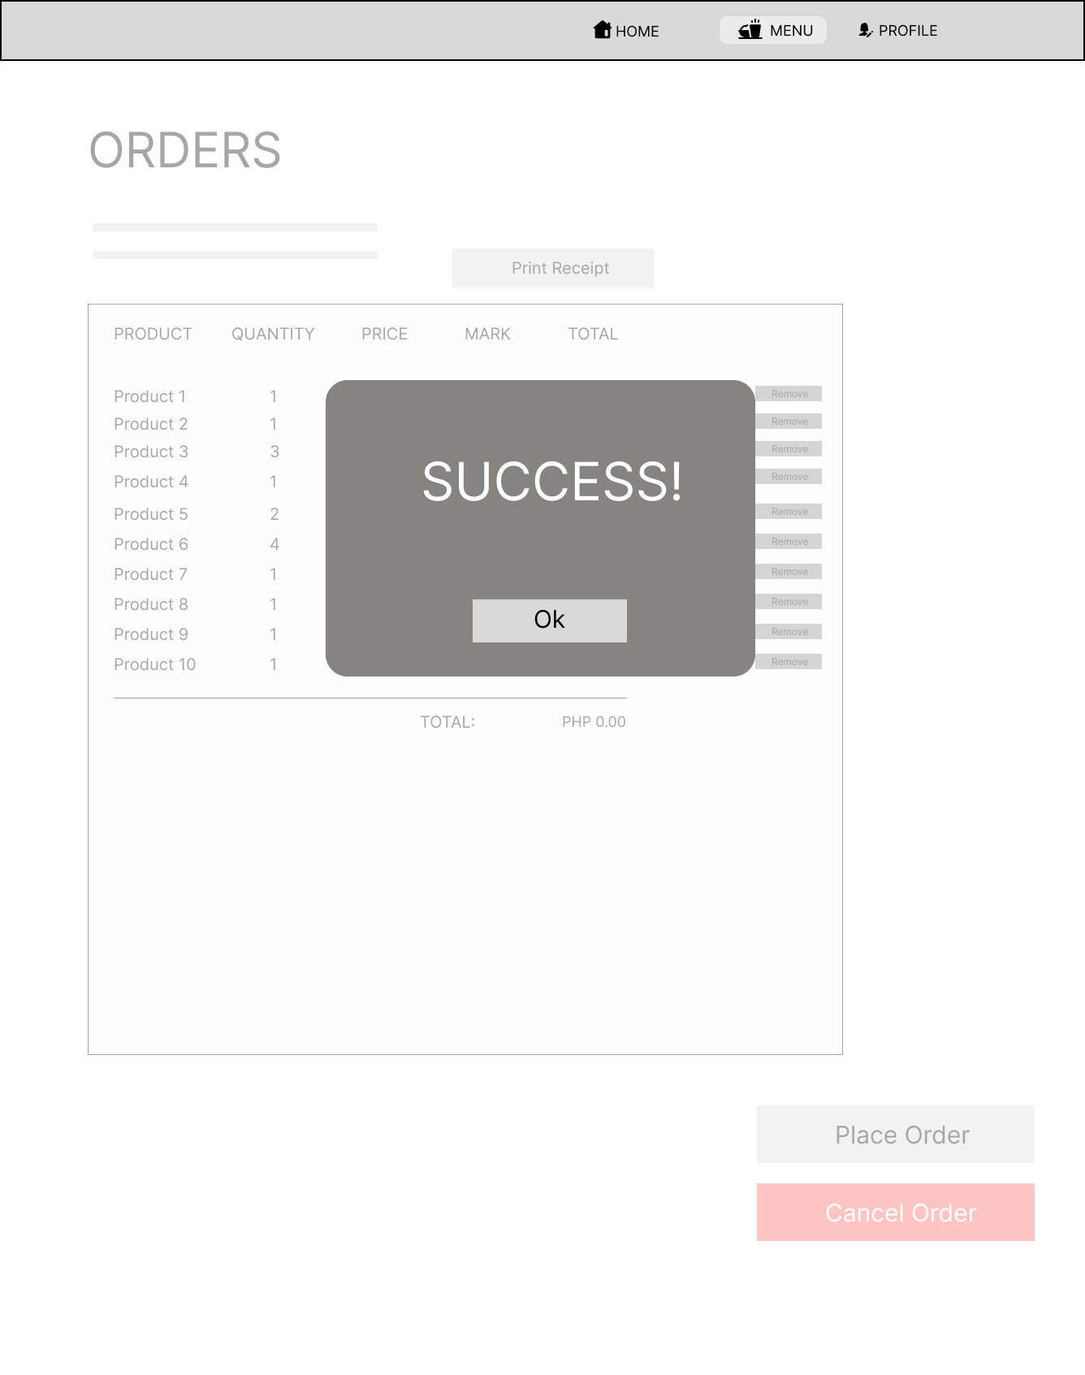
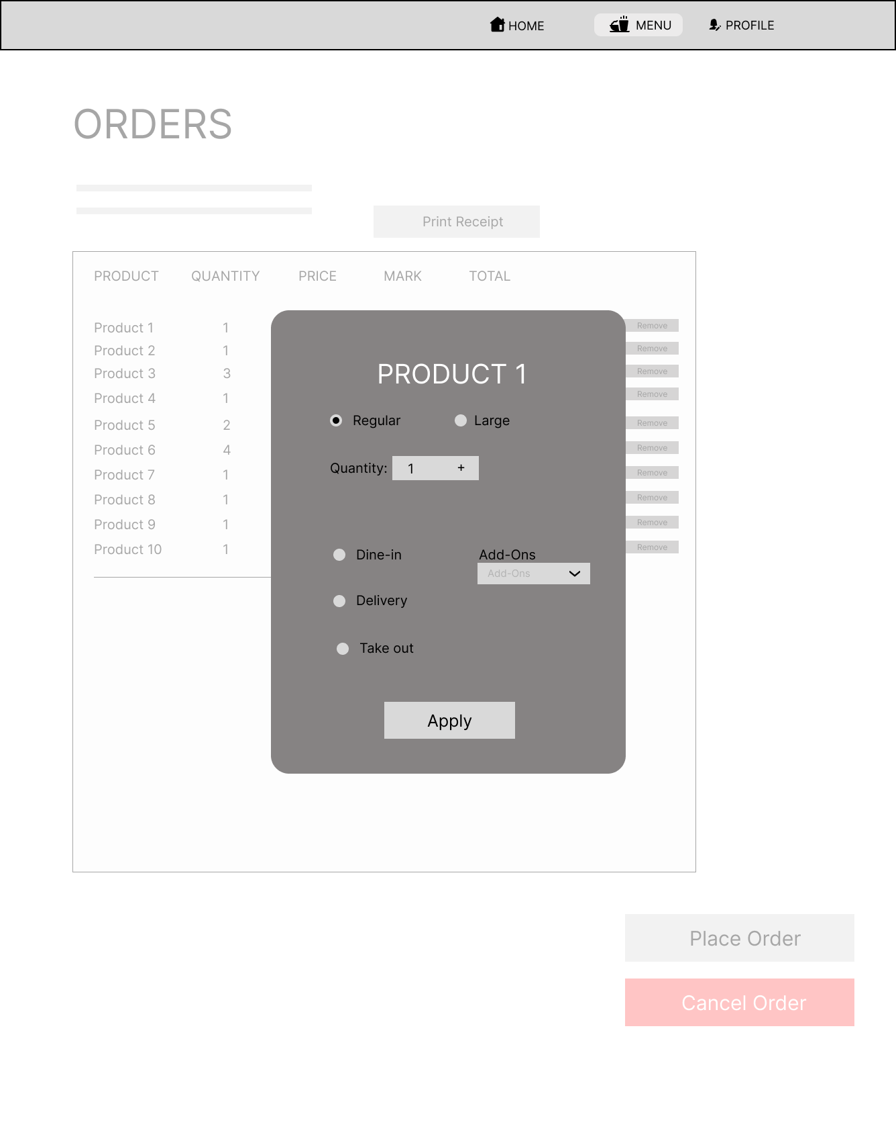
EMPLOYEE DASHBOARD
LESSON 3
Notes:
INTRODUCE YOURSELF-
ONE PERSON- : GOOD AFTERNOON, I’M ..
2ND PERSON: IM
AND SO ON.
ACQUISITION MEANS TO IMPLEMENT OR TO ACQUIRE
STREAMLINE - TO MAKE AN EFFECTIVE SYSTEM THAT WILL BENEFIT THE CLIENT.
ARLYNE

Slide 17
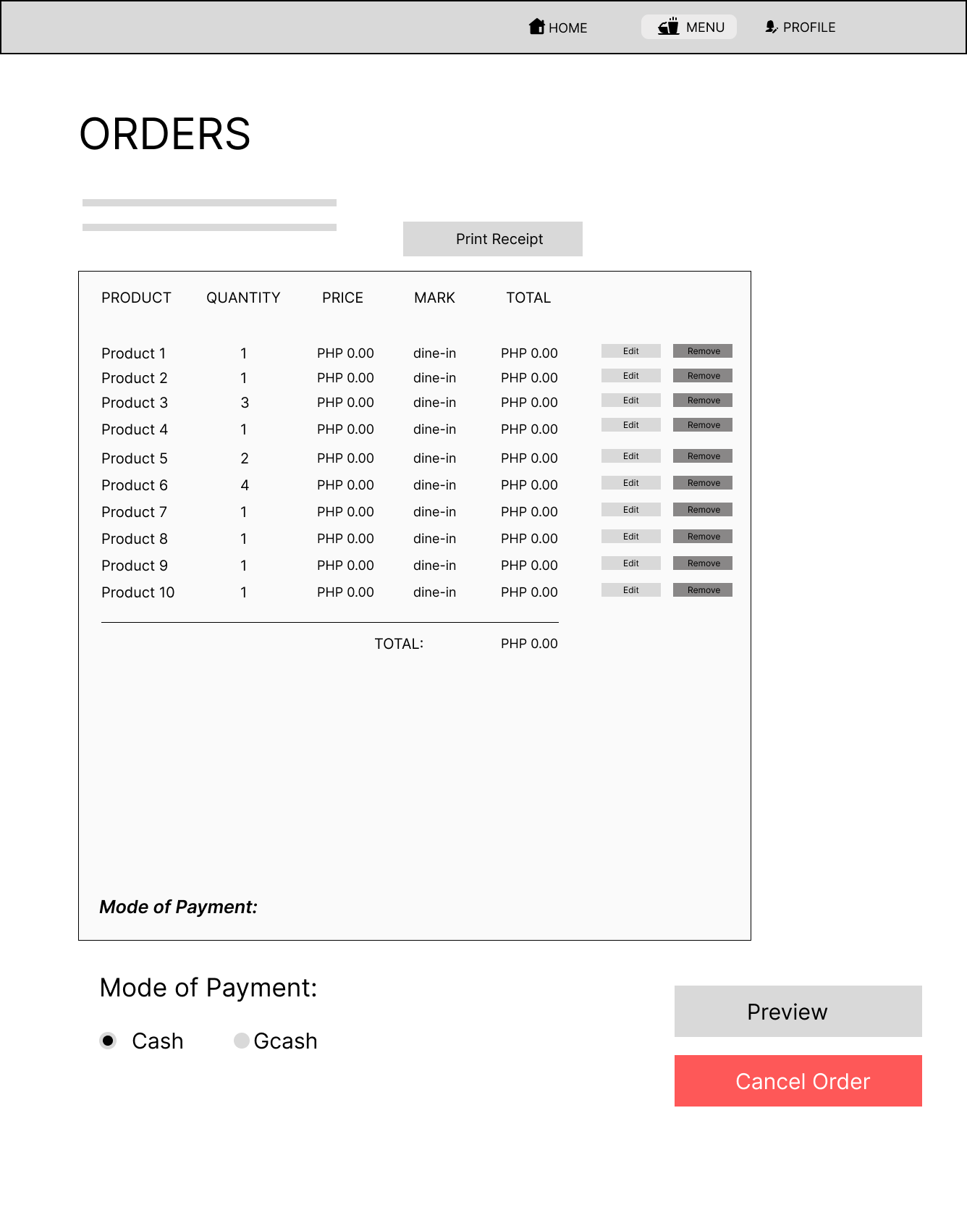
ADMIN DASHBOARD
LESSON 3
Notes:
INTRODUCE YOURSELF-
ONE PERSON- : GOOD AFTERNOON, I’M ..
2ND PERSON: IM
AND SO ON.
ACQUISITION MEANS TO IMPLEMENT OR TO ACQUIRE
STREAMLINE - TO MAKE AN EFFECTIVE SYSTEM THAT WILL BENEFIT THE CLIENT.
ARLYNE

Slide 18

ADMIN DASHBOARD
LESSON 3
Notes:
INTRODUCE YOURSELF-
ONE PERSON- : GOOD AFTERNOON, I’M ..
2ND PERSON: IM
AND SO ON.
ACQUISITION MEANS TO IMPLEMENT OR TO ACQUIRE
STREAMLINE - TO MAKE AN EFFECTIVE SYSTEM THAT WILL BENEFIT THE CLIENT.
ARLYNE

Slide 19
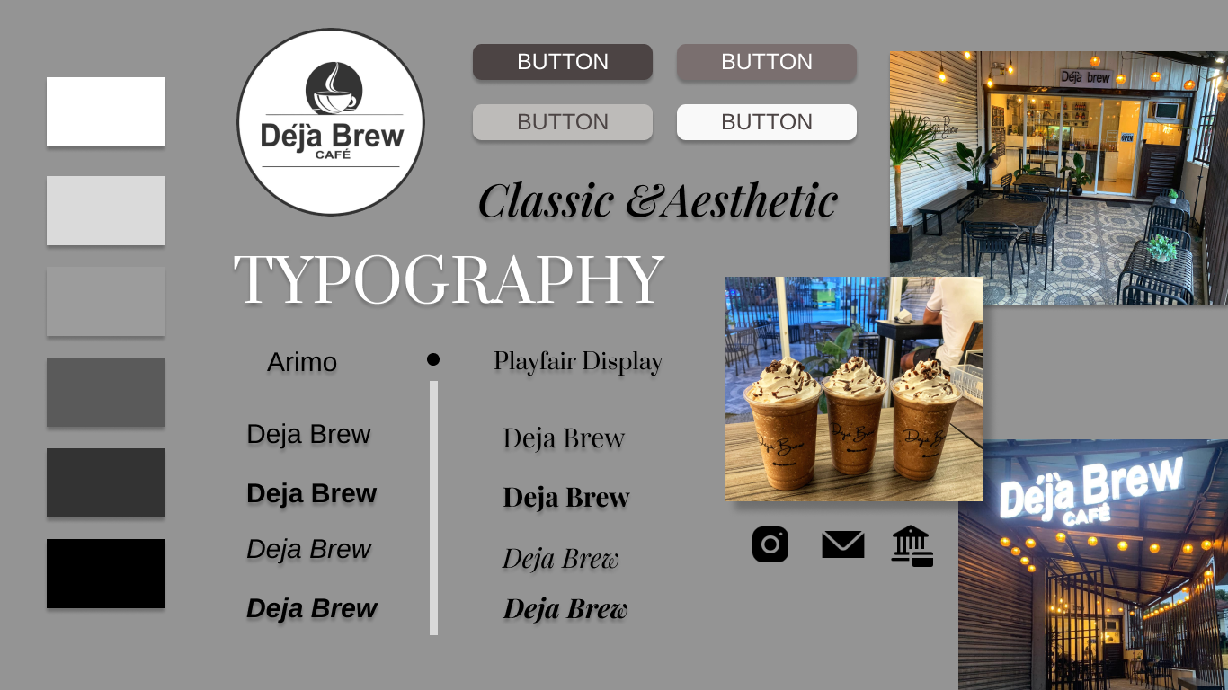
MOODBOARD
LESSON 3
Notes:
INTRODUCE YOURSELF-
ONE PERSON- : GOOD AFTERNOON, I’M ..
2ND PERSON: IM
AND SO ON.
ACQUISITION MEANS TO IMPLEMENT OR TO ACQUIRE
STREAMLINE - TO MAKE AN EFFECTIVE SYSTEM THAT WILL BENEFIT THE CLIENT.
ARLYNE

Slide 20
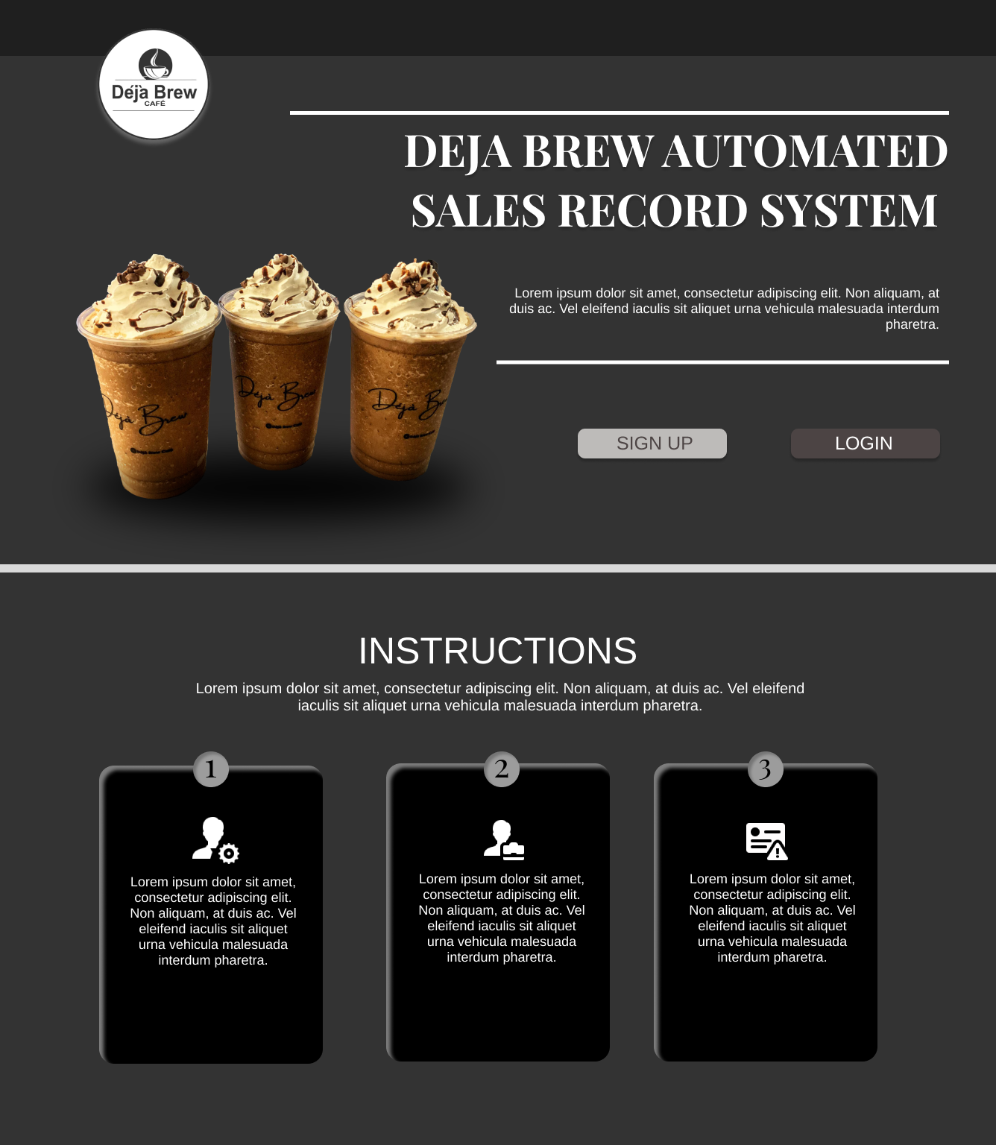
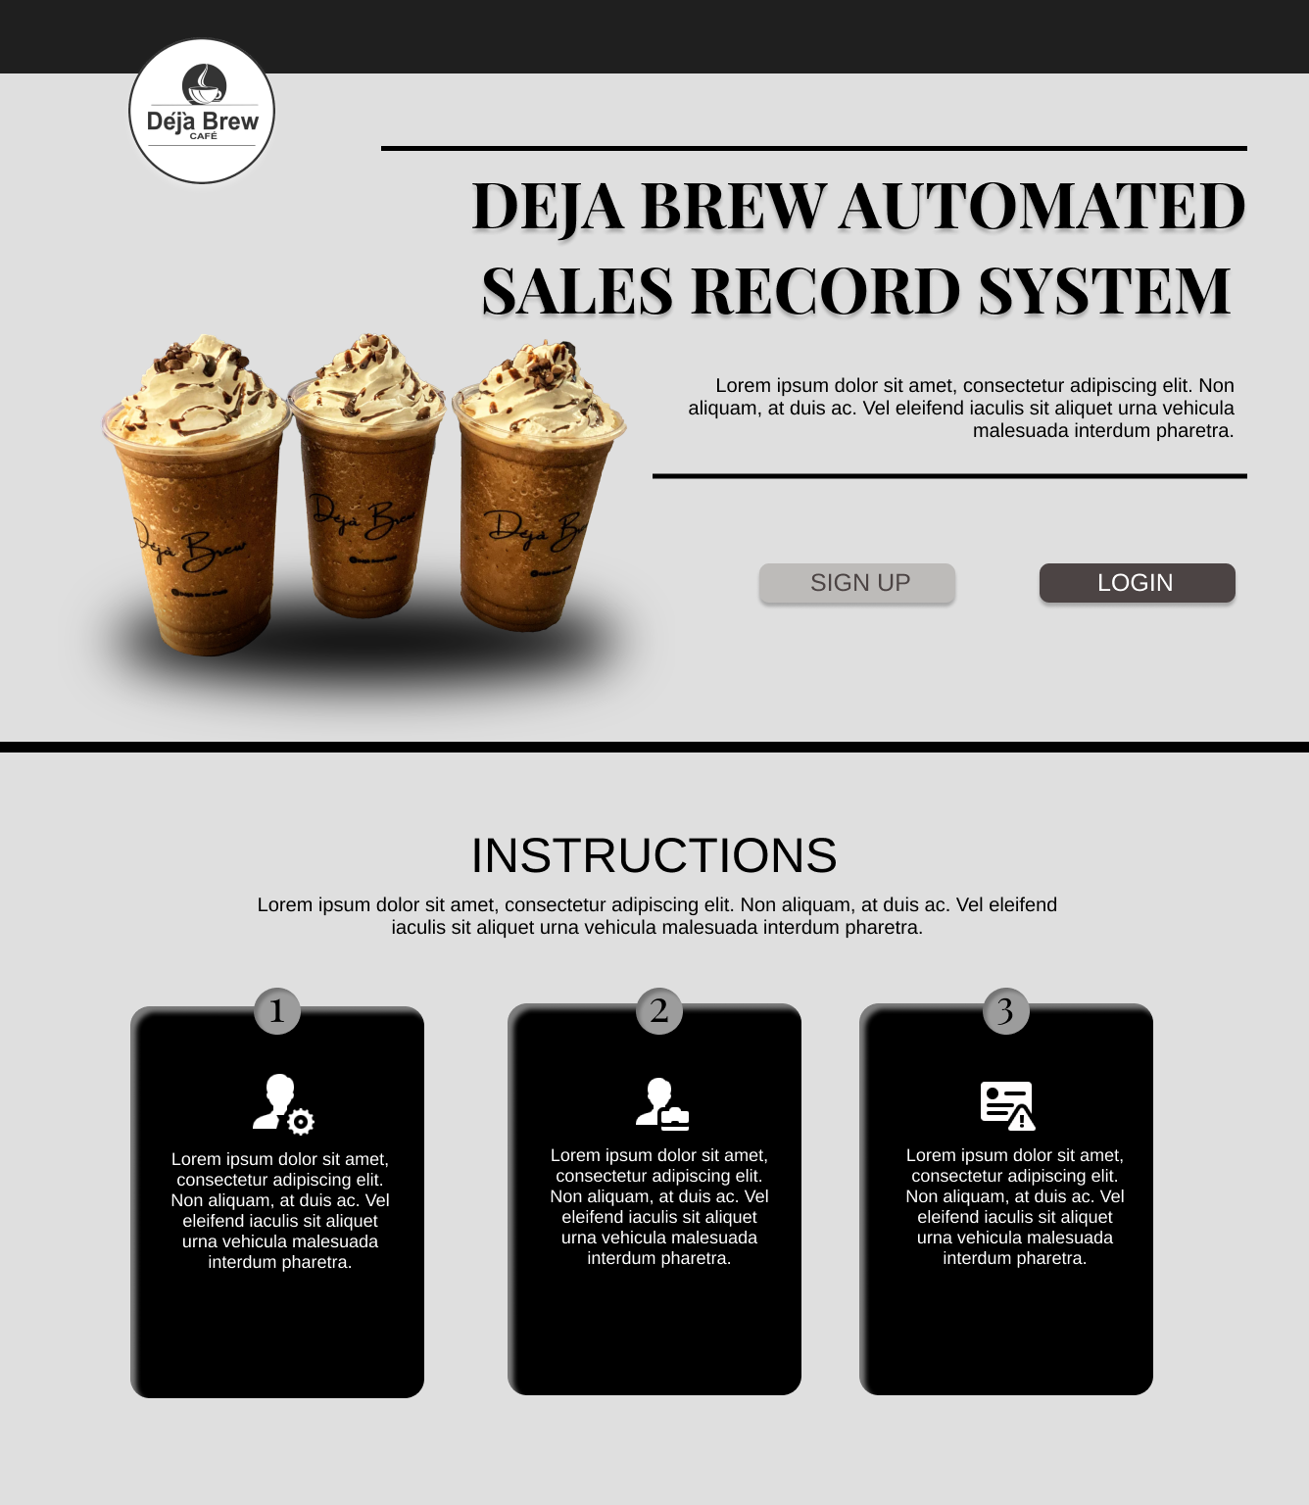
SAMPLE MOCK UP
LESSON 3
Notes:
INTRODUCE YOURSELF-
ONE PERSON- : GOOD AFTERNOON, I’M ..
2ND PERSON: IM
AND SO ON.
ACQUISITION MEANS TO IMPLEMENT OR TO ACQUIRE
STREAMLINE - TO MAKE AN EFFECTIVE SYSTEM THAT WILL BENEFIT THE CLIENT.
ARLYNE

Slide 21
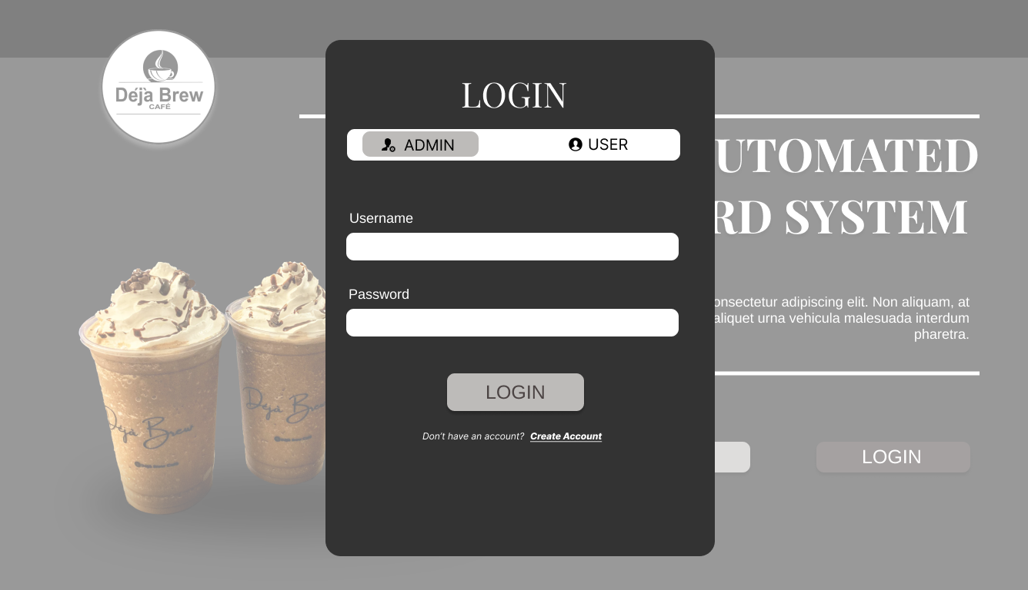
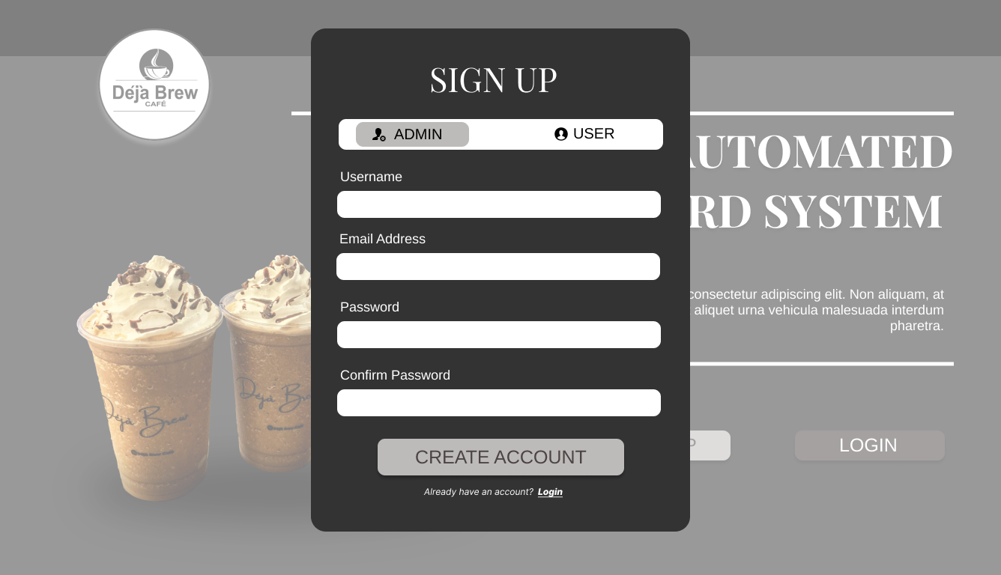
SAMPLE MOCK UP
LESSON 3
Notes:
INTRODUCE YOURSELF-
ONE PERSON- : GOOD AFTERNOON, I’M ..
2ND PERSON: IM
AND SO ON.
ACQUISITION MEANS TO IMPLEMENT OR TO ACQUIRE
STREAMLINE - TO MAKE AN EFFECTIVE SYSTEM THAT WILL BENEFIT THE CLIENT.
ARLYNE

Slide 22
Thank you and God bless!
LESSON 2
LESSON 3
LESSON 4

